Slide 1


An Introduction to R
Workshop 4
Please record your attendance:
Laura Dean
LIFE4138
laura.dean@nottingham.ac.uk

Slide 2

Homework recap
Let’s go through the answers to the homework from last session

Slide 3
Learning outcomes
VCF files in R
the vcfR package: vcfR and chromR objects
Reading in VCF files
Querying VCF files
Filtering VCF files
Writing out VCF files
Principal components analysis (PCA) in R
Preparing genomic data
Performing PCA
Extracting and plotting results
Running R scripts from the terminal

Slide 4
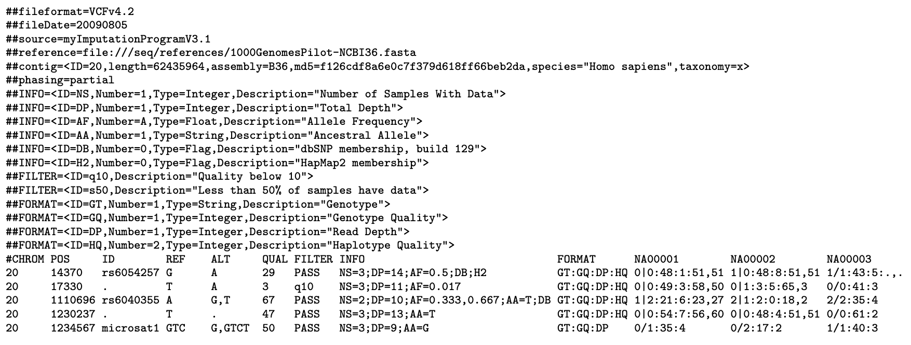
VCF file format
Variant call format

Slide 5
VCF file format
Comment / info lines begin with ##

Slide 6
VCF file format
Header line begins with #
Information block

Slide 7
VCF file format
Genotype data

Slide 8
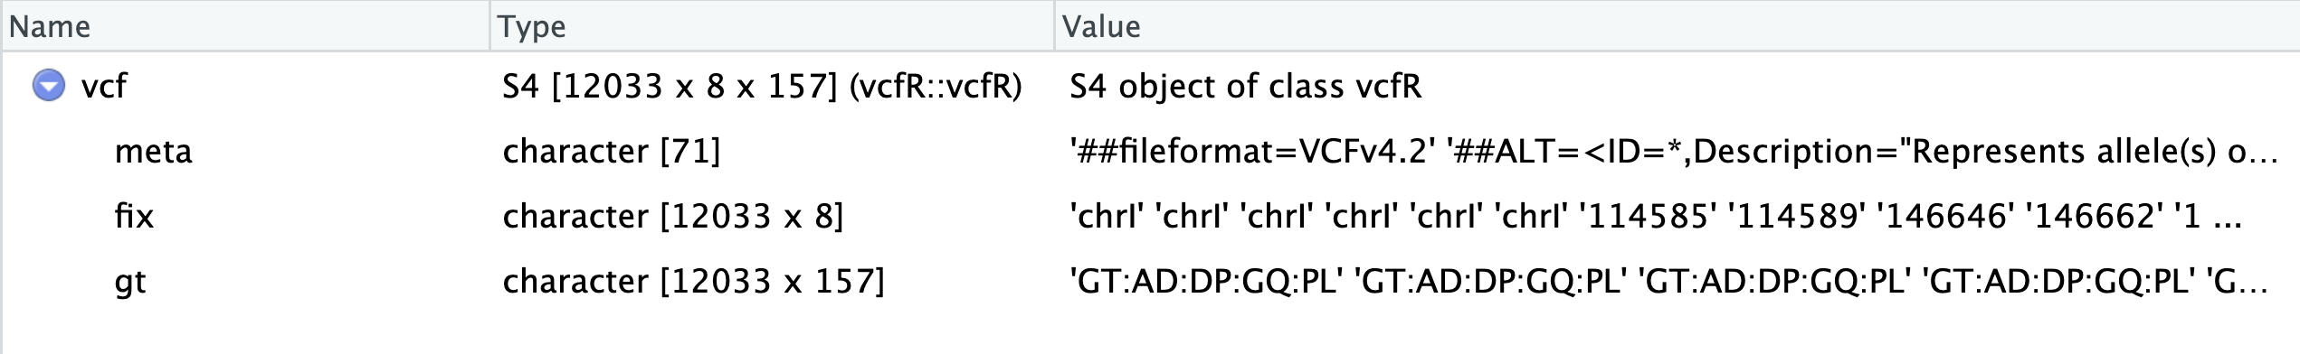
VCF files in R – vcfR objects
Can be read in with the vcfR package
The vcfR object is an S4 class object with three slots:
meta = metadata = the comment lines
fix = fixed data = CHROM, POS, ID, REF, ALT, QUAL, FILTER, INFO
gt = genotype data = genotypes for each individual
Notes:
S4 object is a defined class containing multiple predefined slots. These slots can be accessed with the @ symbol much the same as the $ for data frames.

Slide 9
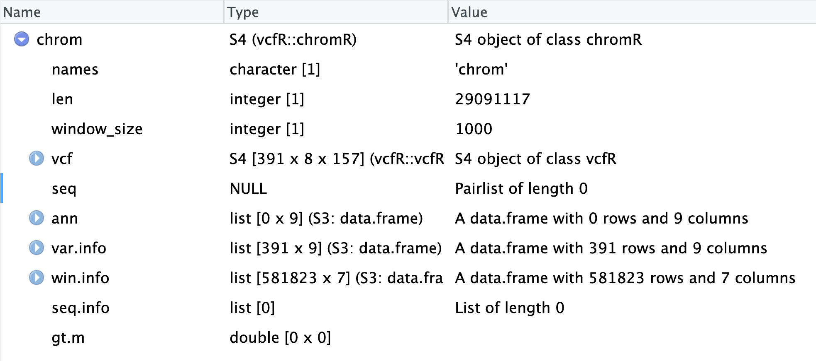
VCF files in R – chromR objects
Can be read in with the vcfR package
The chromR object is an S4 class object with many slots!
name of chromosome
length of chromosome
vcfR object
fasta ref sequence
annotation info
variant filtering info
stats in windows
Notes:
S4 object is a defined class containing multiple predefined slots. These slots can be accessed with the @ symbol much the same as the $ for data frames.

Slide 10
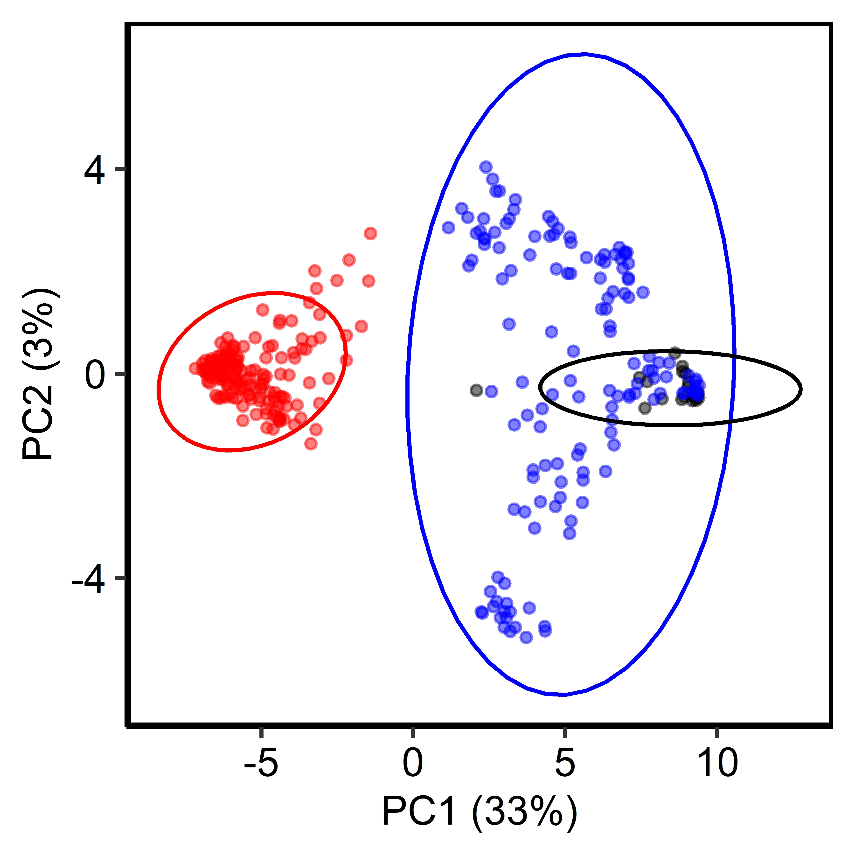
Principal components analysis (PCA)
Reduces dimensionality of many correlated variables
Axes explain the greatest variation in the data
Useful for visualizing and exploring patterns in your data
Use on any continuous data
Notes:
dimensionality reduction technique with applications in exploratory data analysis, visualization and data preprocessing

Slide 11

Running R scripts from the command line
Run R scripts from your terminal with the Rscript command
Allows you to use R as part of an automated pipeline
Means you can use R on machines without a frontend (i.e. as part of a batch job on a HPC)
Allows you to access increased memory & compute power for R
Notes:
dimensionality reduction technique with applications in exploratory data analysis, visualization and data preprocessing

Slide 12
Practical time…
Open R studio and we will work through some examples together

Slide 13
Try it yourself tasks:
Read the VCF file Volucella_bombylans.vcf.gz provided for you on moodle into your R environment (make sure you give it a different name or you will overwrite the other VCF we’ve been working with)
Print the dimensions of the VCF to your R console
Filter the vcf so that it contains only the three individuals: VB20001, VB20005 and VB21020 (remember you will also need to retain the format column)
Query the VCF to see how many sites are biallelic, output the result as a table
Query the VCF to see how many sites are indels, output the result as a table
Show how you would filter the VCF to contain only sites that are NOT indels
Convert your vcfR object to chromR format and plot some general stats on the chromR object (make sure you give your new chromR object a different name too)
BONUS: Make a mask to filter your chromR object – use the plots from question 7 to guide you about where to set your thresholds, write out your filtered vcf to a new file with a different name

Slide 14
Try it yourself tasks:
Make an R script to perform a PCA on the stickleback vcf and save the plot. Test and run your script from the terminal using the command Rscript followed by the name of your script
HINTS:
1. load libraries
2. give the full path to your files or set working directory within script
3. make the PCA command non-user input

Slide 15
Homework!
Please record your attendance:
Work your way through the R scripts you created in each of the 4 workshops and re-run everything to recap what you have learned!

